Slide 1
CALL CENTER CASE STUDY
Case Study Based on CallIn Call Centre and Royal Bank of Scotland
Old Data Irregularity Audit by Brent Associates
PART 1

Slide 2
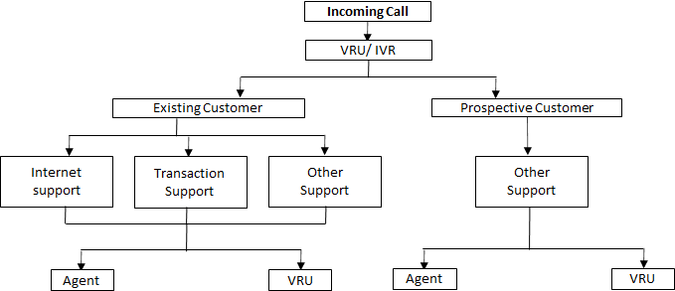
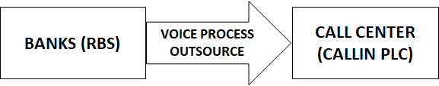
Problem Background
Services Handled:
Transaction information (Existing Customer)
VRU (Voice Response Unit)
Other information (Prospective Customers)
Internet Customer Support

Slide 3
Problem Introduction & Statement
RBS appoints your firm (Brent Associates) to audit
Apart from current year, one year is assigned randomly for audit
Any past irregularities by the then auditors
Any irregularity that was missed in earlier reporting
To account for any unknown/ unaccounted cash excess and/ or shortfall
Transactions with CallIn PLC for February 1999 are to be audited. Statement of payout has been given and it has to be assessed whether the transaction was correct.
While solving this case study, answer the Multiple Choice Questions

Slide 4
Data Dictionary
FIELD | FIELD TYPE | LENGTH | EXPLANATION
Type | Text | 2 char | PS - regular activity PE - regular activity in English IN - internet consulting NE -stock exchange activity NW - potential customer getting information TT – customers who left a message asking the bank to return their call but, while the system returned their call, the calling-agent became busy hence the customers were put on hold in the queue.
Date | Numeric | 5 char | Year-month-date (YYMMDD)
vru_entry | Time | 6 char | Time that the phone-call enters
vru_exit | Time | 6 char | Time of exit from the VRU: either to the queue, or directly to receive service, or to leave the system (abandonment).
Q_start | Time | 6 char | Time of joining the queue (being put on “hold”).
Q_exit | Time | 6 char | Time (in seconds) of exiting the queue
Outcome | Text | 4/5/7 char | AGENT – service HANG - hung up PHANTOM - a virtual call to be ignored
Ser_start | Time | 6 char | Time of beginning of service by agent.
Ser_exit | Time | 6 char | Time of end of service by agent.
Server | String | Undefined | Name of the agent who served the call. This field is NO_SERVER, if no service was provided.
FIELD | FIELD TYPE | LENGTH | EXPLANATION
vru+line | Alpha numeric | 6 char | Centre has 65 lines and 6 VRUs. Each call is assigned a VRU
Call_id | Numeric | 5 char | Each entering call is assigned a call id.
Customer_id | Numeric | Upto 12 char | Unique ID of caller; the ID is zero if the caller is not identified by the system (as is the case for prospective customers, for example).
Priority | Numeric | 1 char | 0 and 1 indicate unidentified customers or regular customers 2 indicates priority customers Customers are served in the order of their "Time in Queue". Priority customers are allocated at the outset of their call 1.5 minutes of waiting-time Due to a system bug, customer I.D. was not recorded for those who did not wait in queue; hence, their priority is 0.

Slide 5
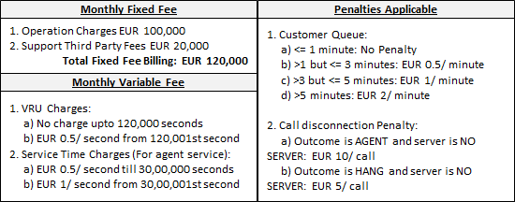
Other Information
Manpower information as been given
Operational timing of call centre are given
Summary of Compensation Structure:

Slide 6
THANK YOU

